Slide 1
sociology
Notes:
What?
Study of life with other people (society) Why?
The unexamined life is not worth living
To be compassionate, to understand other people
To provide evidence for policy makers
Sociology is challenging, part of common-sense, sprawling, argumentative, fascinating, uncertain
In short Sociology is the BIG ONE
With lots of neighbouring disciplines – psychology, geography, economics, politics, history, anthropology, and criminology

Slide 2
Are Things Getting Better? Worldwide Happiness and Well Being
Notes:
It is possible to know the answers to these questions and to use evidence to measure these questions.

Slide 3
Today
Outline trends in life satisfaction in the UK over the last decade
Distinguish between subjective and objective well being and some different ways of measuring them
Explore different ways of measuring well being and happiness and decide if worldwide happiness and wellbeing is increasing

Slide 4
Happiness is when you can …………
Notes:
Complete the sentence on the white board or the whiteboards or post-it notes

Slide 5
Overall, how satisfied are you with your life nowadays?
Scale of 0-10
Notes:
Data from June 2020 – 7.75 in Q3 2019, 7.13 in June 2020 6.4 in Jan 21

Slide 6
Overall, how satisfied are you with your life nowadays?
Scale of 0-10
What do you think the average score is for the UK?
Notes:
Data from June 2020 – 7.75 in Q3 2019, 7.13 in June 2020 6.4 in Jan 21 and 6.8 in March 21

Slide 7
Notes:
From annual population survey and weekly opinions and lifestyle survey from March 2020

Slide 8
Are things getting better? How unfair is the world?
The social sciences allow us to ask important empirical questions
Notes:
Empirical means something that uses data and evidence

Slide 9
Cantril Ladder
up and down the ladder by Robert Couse-Baker is licensed with CC BY 2.0.
Notes:
Some people are more eore than others
Some people are happier than others
See list p5 Argyle the Psychology of Happiness
The main life evaluation question asked in the poll is: “Please imagine a ladder, with steps numbered from 0 at the bottom to 10 at the top. The top of the ladder represents the best possible life for you and the bottom of the ladder represents the worst possible life for you. On which step of the ladder would you say you personally feel you stand at this time?” (Also known as the “Cantril Ladder”.) – From Ortiz – Ospiner and Roser 2017
Cantril ladder is used by Gallup for worldwide surveys – uses following categories – based on present and future
Thriving -- well-being that is strong, consistent, and progressing. These respondents have positive views of their present life situation (7+) and have positive views of the next five years (8+). They report significantly fewer health problems, fewer sick days, less worry, stress, sadness, anger, and more happiness, enjoyment, interest, and respect.
Struggling -- well-being that is moderate or inconsistent. These respondents have moderate views of their present life situation OR moderate OR negative views of their future. They are either struggling in the present, or expect to struggle in the future. They report more daily stress and worry about money than the "thriving" respondents, and more than double the amount of sick days. They are more likely to smoke, and are less likely to eat healthy.
Suffering -- well-being that is at high risk. These respondents have poor ratings of their current life situation (4 and below) AND negative views of the next five years (4 and below). They are more likely to report lacking the basics of food and shelter, more likely to have physical pain, a lot of stress, worry, sadness, and anger. They have less access to health insurance and care, and more than double the disease burden, in comparison to "thriving" respondents.

Slide 10
Cantril Ladder
“Please imagine a ladder, with steps numbered from 0 at the bottom to 10 at the top. The top of the ladder represents the best possible life for you and the bottom of the ladder represents the worst possible life for you. On which step of the ladder would you say you personally feel you stand at this time?”
Thriving 7+ well-being that is strong, consistent, and progressing.
Struggling 5, 6 well-being that is moderate or inconsistent.5, 6 These respondents have moderate views of their present life situation OR moderate OR negative views of their future.
Suffering below 4 well-being that is at high risk. These respondents have poor ratings of their current life situation
Source Gallup 2019
Notes:
Some people are more eore (sadder) than others
Some people are happier than others
See list p5 Argyle the Psychology of Happiness
The main life evaluation question asked in the poll is: “Please imagine a ladder, with steps numbered from 0 at the bottom to 10 at the top. The top of the ladder represents the best possible life for you and the bottom of the ladder represents the worst possible life for you. On which step of the ladder would you say you personally feel you stand at this time?” (Also known as the “Cantril Ladder”.) – From Ortiz – Ospiner and Roser 2017
Cantril ladder is used by Gallup for worldwide surveys – uses following categories – based on present and future
Thriving -- well-being that is strong, consistent, and progressing. These respondents have positive views of their present life situation (7+) and have positive views of the next five years (8+). They report significantly fewer health problems, fewer sick days, less worry, stress, sadness, anger, and more happiness, enjoyment, interest, and respect.
Struggling -- well-being that is moderate or inconsistent. These respondents have moderate views of their present life situation OR moderate OR negative views of their future. They are either struggling in the present, or expect to struggle in the future. They report more daily stress and worry about money than the "thriving" respondents, and more than double the amount of sick days. They are more likely to smoke, and are less likely to eat healthy.
Suffering -- well-being that is at high risk. These respondents have poor ratings of their current life situation (4 and below) AND negative views of the next five years (4 and below). They are more likely to report lacking the basics of food and shelter, more likely to have physical pain, a lot of stress, worry, sadness, and anger. They have less access to health insurance and care, and more than double the disease burden, in comparison to "thriving" respondents.

Slide 11
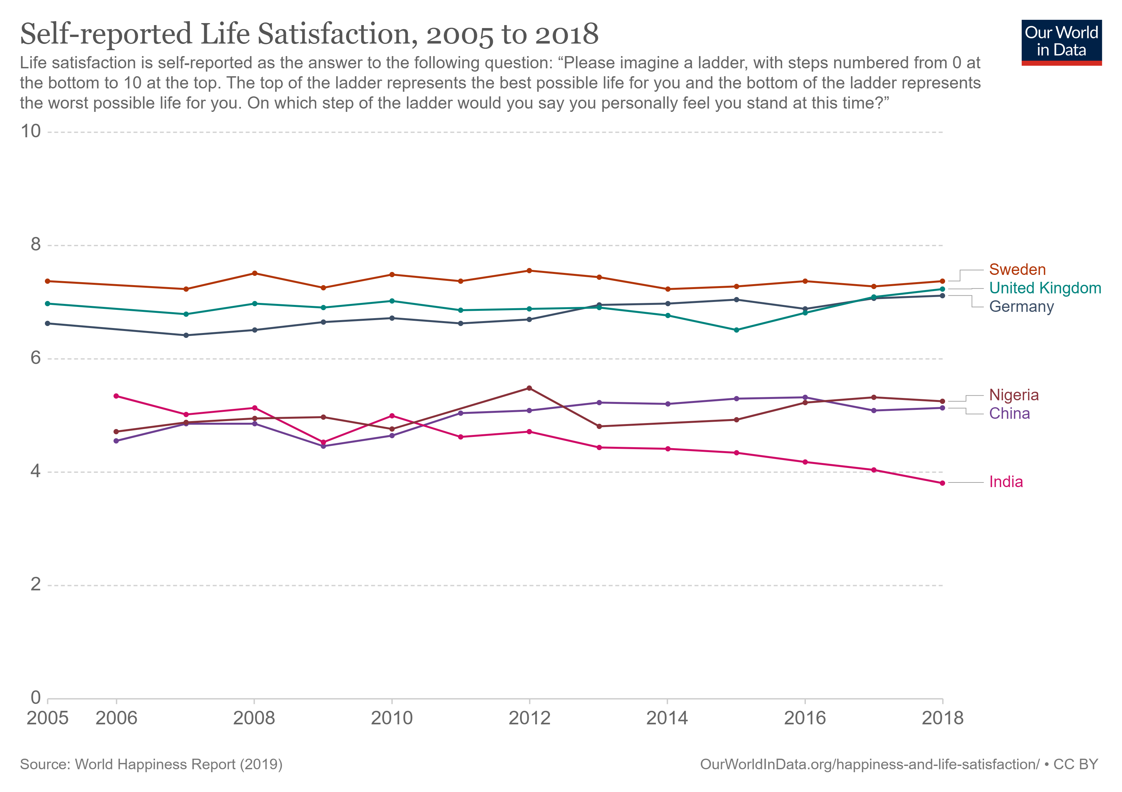
Source Gallup 2019

Slide 12
Cantril Ladder
Self-reported life satisfaction using Cantril ladder 2005-2018 selected countries
Data used in World Happiness Report from Gallup World Poll
Source Gallup 2019

Slide 13
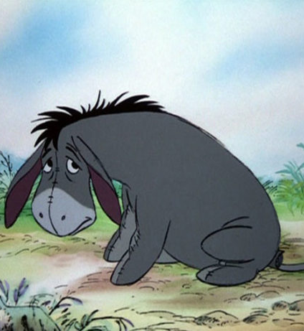
Distribution of Happiness? Income does seem to matter.
The happiness of others
We seem to think others are less happy than they are
Notes:
We are very Eore

Slide 14
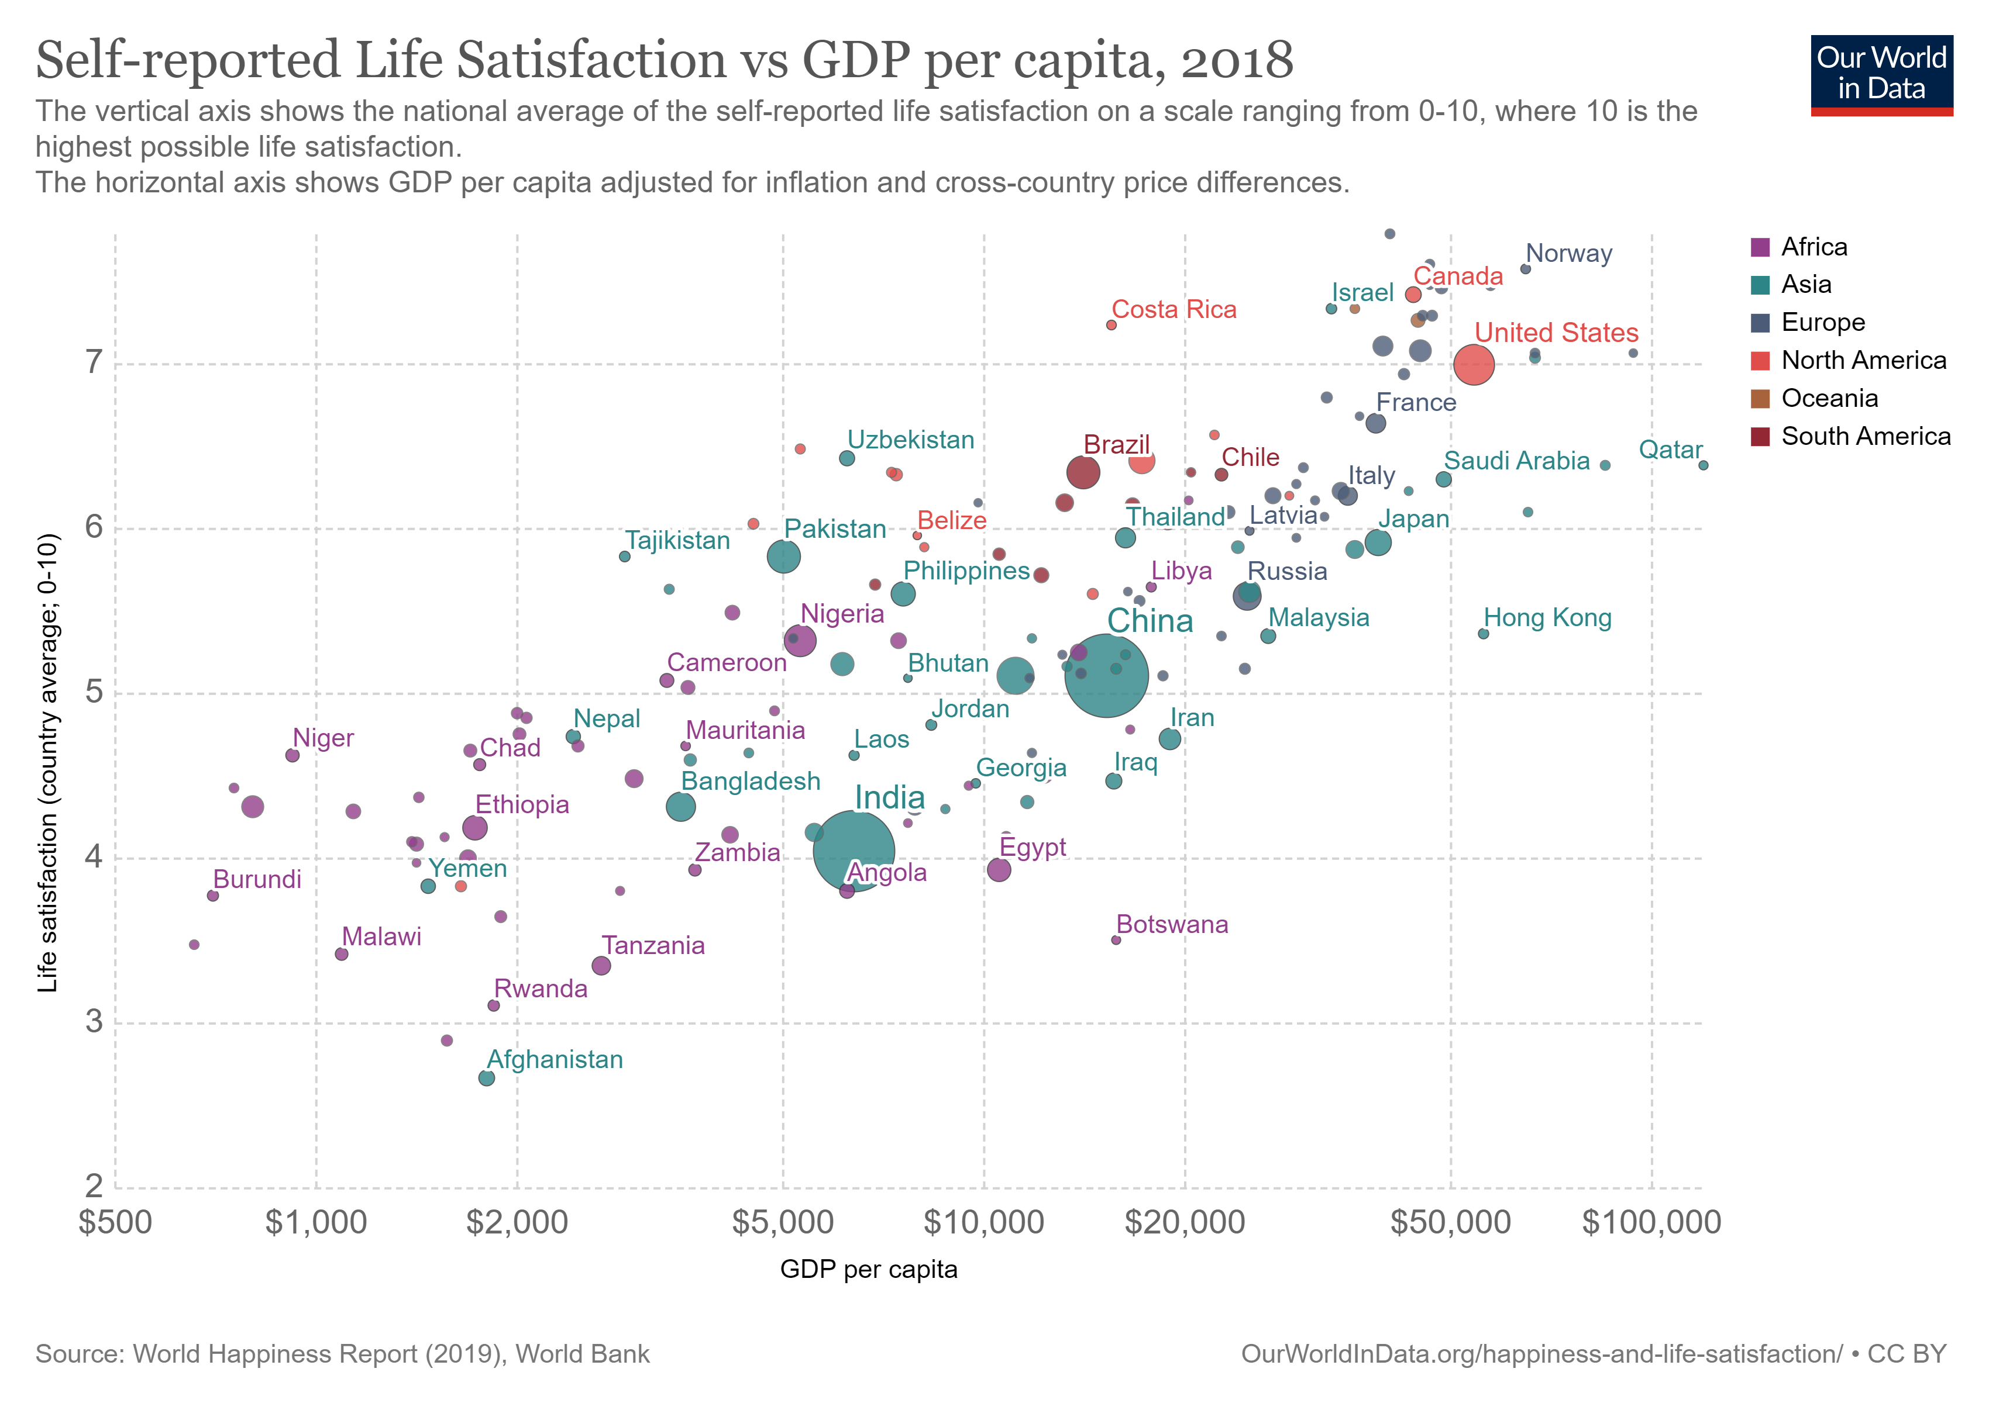
Source Gallup 2019

Slide 15
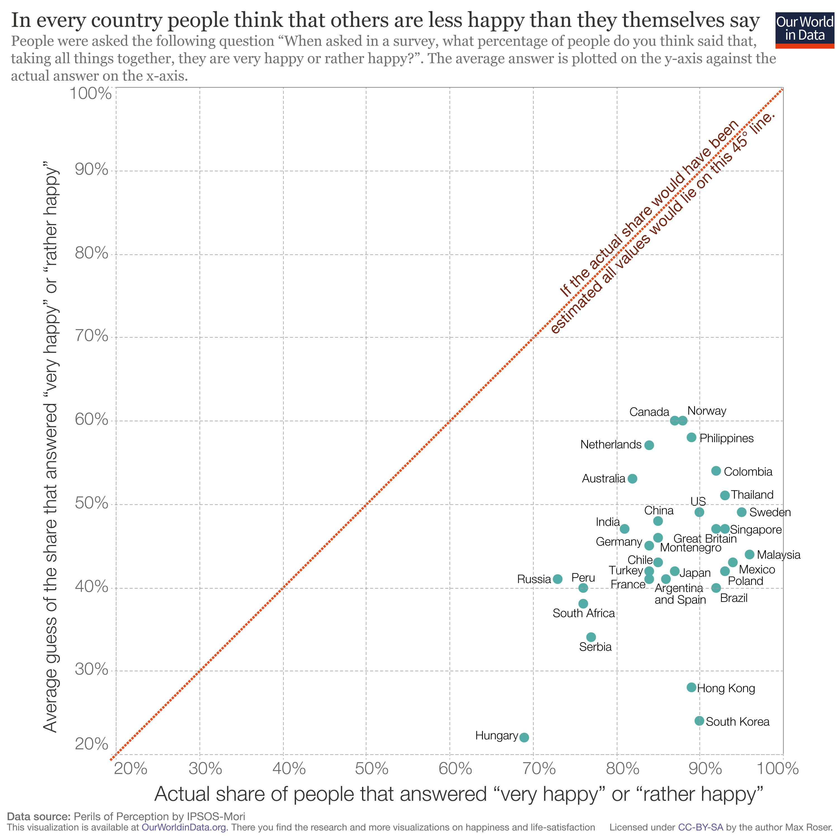
The happiness of others
Source Gallup 2019

Slide 16
What is a good life?
Except for subjective feelings of satisfaction, how else could we measure if a group of people are living a good life?
Notes:
Already have one clue in the previous figure

Slide 17
Think about the whole world During your life have the following gone up or gone down?
 | Increase | Decrease
Life expectancy
Number of people in poverty
Levels of violence

Slide 18
Link here as well

Slide 19
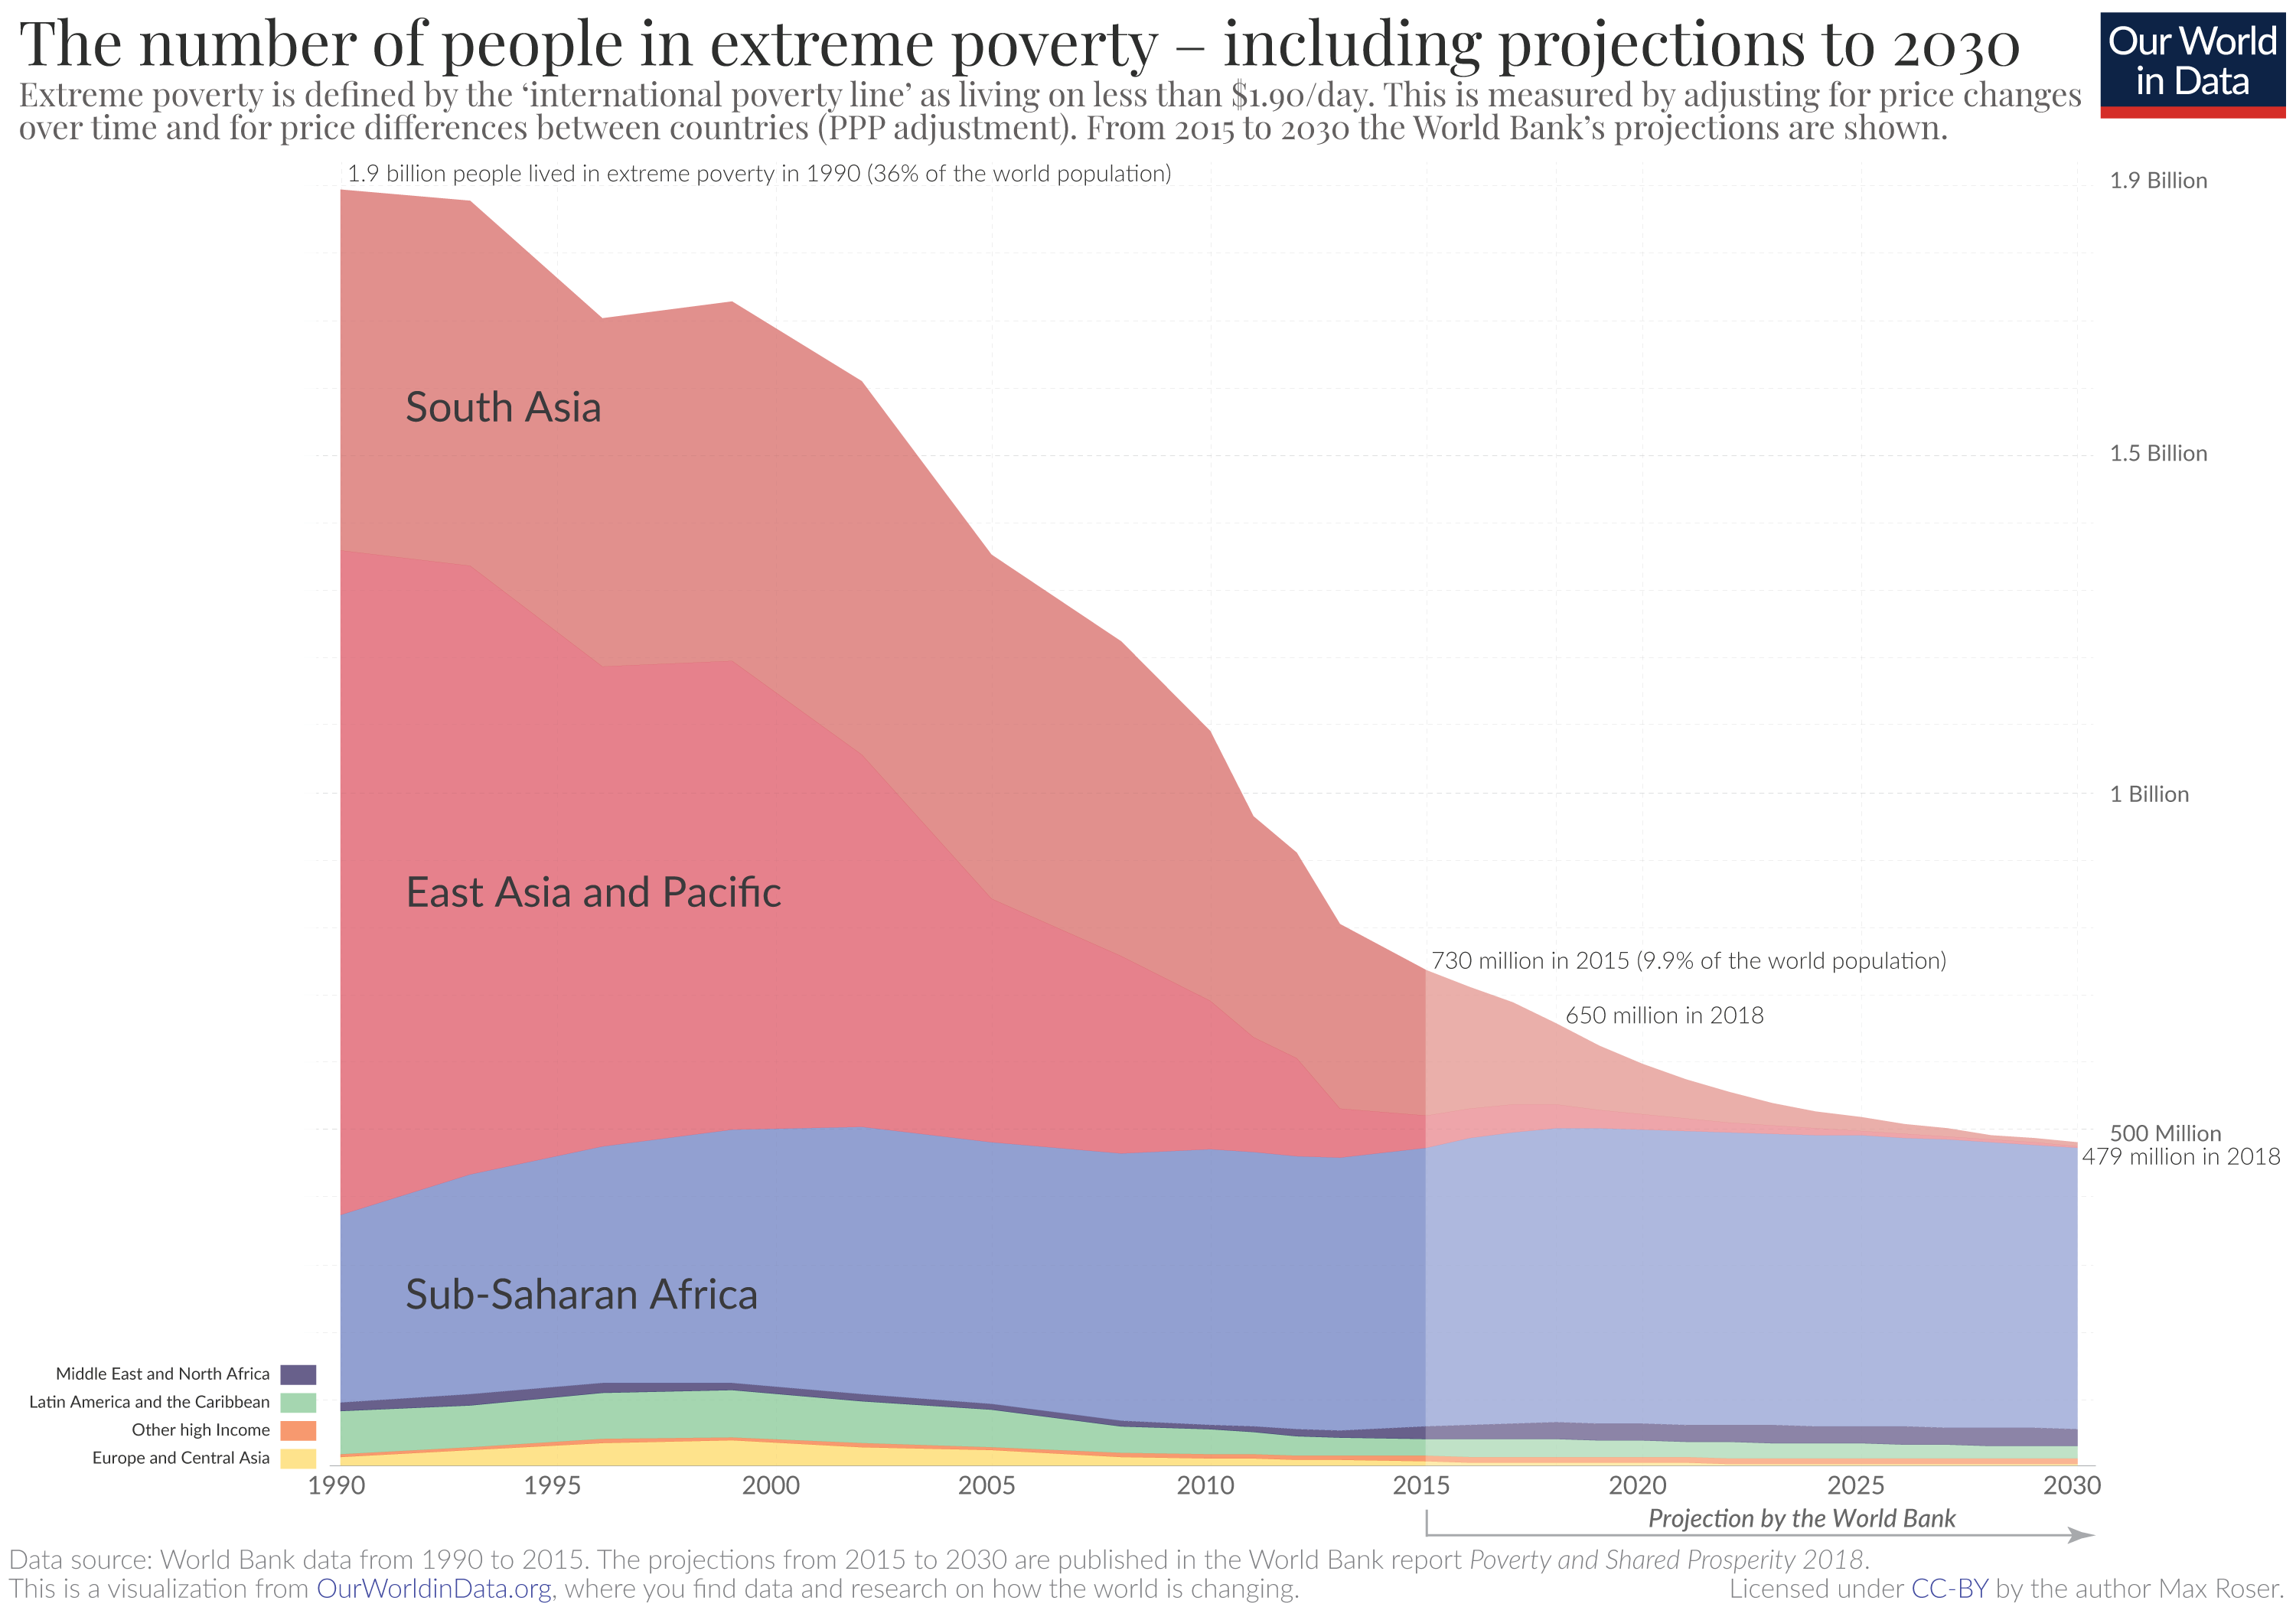

Slide 20
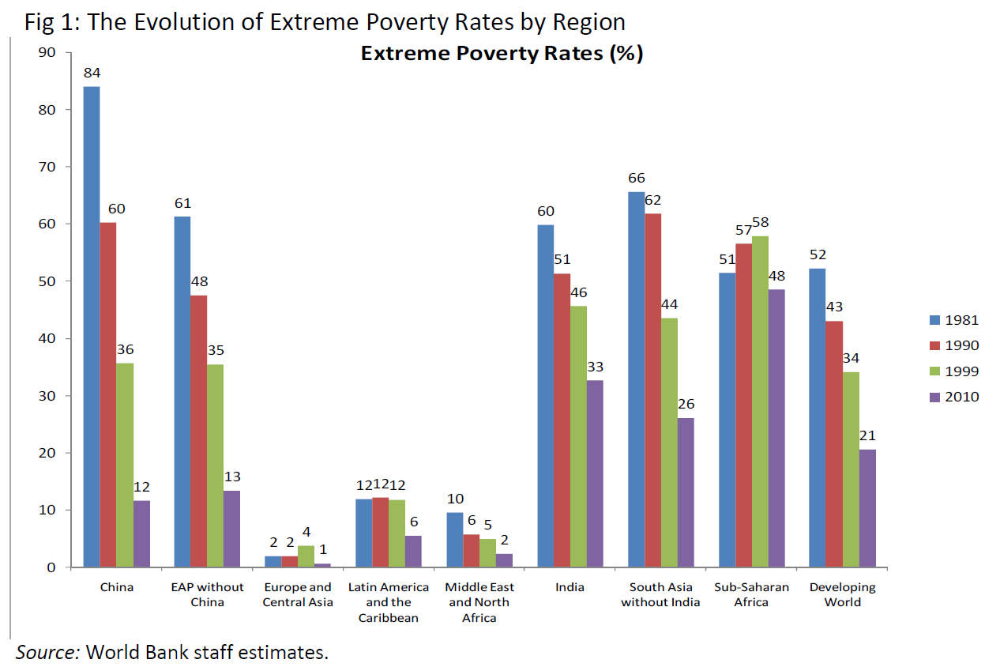
Poverty
Again gapminder
or even HDR
Extreme poverty = less than $1.25 per day

Slide 22
Source: ONS – Crime Survey for England and Wales 2020
Notes:
Note that this is incidents. Nowadays often use measure of number of victims which produces lower figures as many people are a victim many times

Slide 23
What can we conclude from looking at the data? Does that mean things are getting better?
 | Increase | Decrease
Life expectancy
Number of people in poverty
Levels of violence

Slide 24
Any questions?
d.james@uos.ac.uk

Slide 25
Neither the life of an individual nor the history of a society can be understood without understanding both.
C Wright Mills
Notes:
Neither the life of an individual nor the history of a society can be understood without understanding both. C Wright Mills

